Slide 1
0 | 0 | 1 | 0
0 | 1 | 0.5 | 0
0 | 0.5 | 1 | 0.5
0.5 | 1 | 0.5 | 1
0
0
0
0.5
0
0
0
0.5
0
1
0.5
1
0
1
0.5
1
1
0.5
1
0.5
1
0.5
1
0.5
0
0
0.5
1
0
0
0.5
1

Slide 2
+
+
+
+
–
+
–
+
+
–
–
–
+
–

Slide 3
–
+
+
+
–
–
–
–
–
–
+
+
–
–
–
+
–
+
–
–
+
+
–
+
+
–
+
–
+
–
+
+
–
–
+
+
+
–
+
–
–
–
+
+
+
–
–
–
+
+
+
+
+
+
–
–
+
+
+
+
–
+
+
–
+
–
–
–
–
+
–
+
–
–
–
–
+
–
–
–
+
+
–
–
–
–
–
–
–
+
+
–
–
–
–
–
–
+
+
–
–

Slide 4
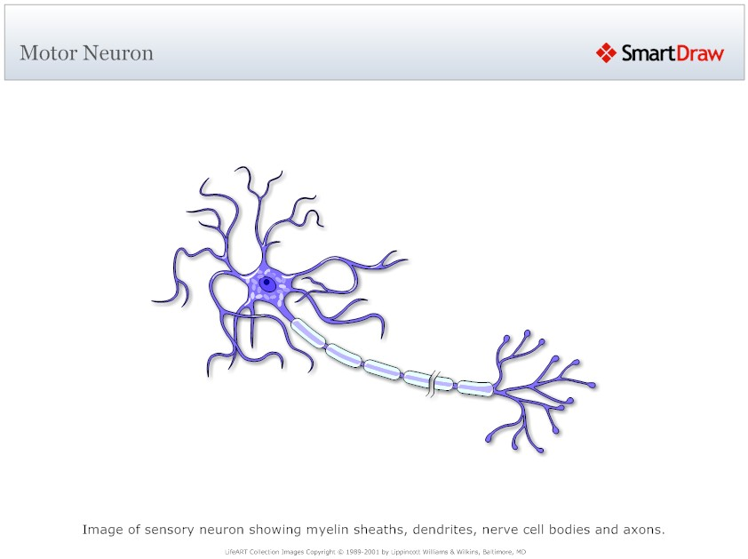
Inputs
Strengths
dendrites
Sum
Transform
Output

Slide 5
synaptic terminal
dendrites
cell body
axon
Inputs
Strengths
Sum
Transform
Output

Slide 6
0 | 0 | 1 | 0
0 | 1 | 0.5 | 0
0 | 0.5 | 1 | 0.5
0.5 | 1 | 0.5 | 1

Slide 8
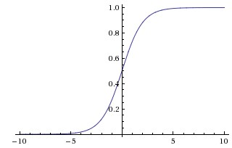

Slide 9
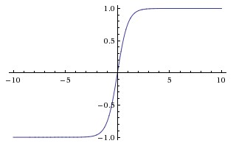

Slide 10
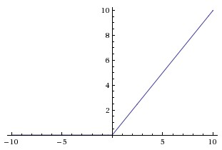

Slide 14


Slide 15
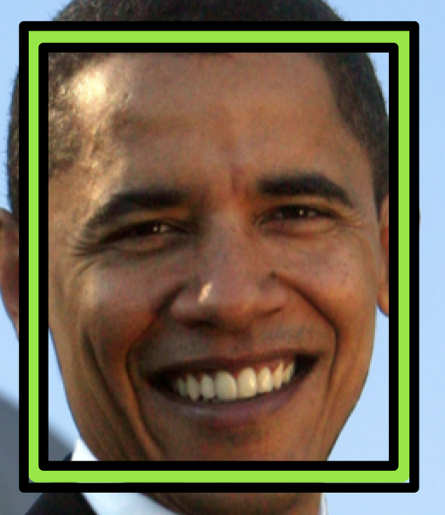

Slide 17
d
w
h

Slide 18
?

Slide 20
Feature Map
Filter

Slide 21
Filter
1
-1
2
8
7
-7
-2
5
8
-7
5
1
5
3
-4
2
2
-1
1
5
3
-4
2
2
-1
S = 1
S = 2

Slide 22
0 | 0 | 0 | 0 | 0 | 0 | 0
0 | -1 | 1 | 1 | 1 | -1 | 0
0 | 1 | -1 | 1 | 1 | -1 | 0
0 | 0 | -1 | 1 | 1 | 0 | 0
0 | -1 | 1 | 1 | 1 | 0 | 0
0 | 1 | 1 | -1 | 1 | -1 | 0
0 | 0 | 0 | 0 | 0 | 0 | 0
0 | 0 | 0
0 | -1 | 1
0 | 1 | -1
1 | 0 | 0
0 | 1 | 1
1 | -1 | -1
0 | 0 | 0 | 0 | 0 | 0 | 0
0 | 1 | -1 | -1 | 1 | -1 | 0
0 | 1 | -1 | 0 | 1 | -1 | 0
0 | 1 | 0 | 0 | -1 | 0 | 0
0 | -1 | 1 | 1 | 1 | 1 | 0
0 | -1 | 1 | 0 | -1 | -1 | 0
0 | 0 | 0 | 0 | 0 | 0 | 0
7 | -3 | -2
-3 | 1 | 3
-2 | 4 | 2
1 | 0 | 0
0 | 0 | -1
0 | 1 | 1
1 | 1 | 0
1 | 1 | -1
1 | -1 | -1
3 | -6 | 3
1 | -1 | 2
-1 | 5 | 0
0 | 0 | 0 | 0 | 0 | 0 | 0
0 | 1 | -1 | -1 | 0 | -1 | 0
0 | 1 | -1 | 0 | 1 | 0 | 0
0 | 1 | 0 | 0 | -1 | 0 | 0
0 | 0 | 1 | 0 | 0 | 1 | 0
0 | -1 | -1 | 1 | -1 | 0 | 0
0 | 0 | 0 | 0 | 0 | 0 | 0
1 | 1 | 1
1 | 1 | 1
0 | 1 | -1
0 | 0 | 0
0 | 0 | 0
0 | 1 | 0

Slide 23
0 | 0 | 0 | 0 | 0 | 0 | 0
0 | -1 | 1 | 1 | 1 | -1 | 0
0 | 1 | -1 | 1 | 1 | -1 | 0
0 | 0 | -1 | 1 | 1 | 0 | 0
0 | -1 | 1 | 1 | 1 | 0 | 0
0 | 1 | 1 | -1 | 1 | -1 | 0
0 | 0 | 0 | 0 | 0 | 0 | 0
0 | 0 | 0
0 | -1 | 1
0 | 1 | -1
1 | 0 | 0
0 | 1 | 1
1 | -1 | -1
0 | 0 | 0 | 0 | 0 | 0 | 0
0 | 1 | -1 | -1 | 1 | -1 | 0
0 | 1 | -1 | 0 | 1 | -1 | 0
0 | 1 | 0 | 0 | -1 | 0 | 0
0 | -1 | 1 | 1 | 1 | 1 | 0
0 | -1 | 1 | 0 | -1 | -1 | 0
0 | 0 | 0 | 0 | 0 | 0 | 0
7 | -3 | -2
-3 | 1 | 3
-2 | 4 | 2
1 | 0 | 0
0 | 0 | -1
0 | 1 | 1
1 | 1 | 0
1 | 1 | -1
1 | -1 | -1
3 | -6 | 3
1 | -1 | 2
-1 | 5 | 0
0 | 0 | 0 | 0 | 0 | 0 | 0
0 | 1 | -1 | -1 | 0 | -1 | 0
0 | 1 | -1 | 0 | 1 | 0 | 0
0 | 1 | 0 | 0 | -1 | 0 | 0
0 | 0 | 1 | 0 | 0 | 1 | 0
0 | -1 | -1 | 1 | -1 | 0 | 0
0 | 0 | 0 | 0 | 0 | 0 | 0
1 | 1 | 1
1 | 1 | 1
0 | 1 | -1
0 | 0 | 0
0 | 0 | 0
0 | 1 | 0

Slide 24
0 | 0 | 0 | 0 | 0 | 0 | 0
0 | -1 | 1 | 1 | 1 | -1 | 0
0 | 1 | -1 | 1 | 1 | -1 | 0
0 | 0 | -1 | 1 | 1 | 0 | 0
0 | -1 | 1 | 1 | 1 | 0 | 0
0 | 1 | 1 | -1 | 1 | -1 | 0
0 | 0 | 0 | 0 | 0 | 0 | 0
0 | 0 | 0
0 | -1 | 1
0 | 1 | -1
1 | 0 | 0
0 | 1 | 1
1 | -1 | -1
0 | 0 | 0 | 0 | 0 | 0 | 0
0 | 1 | -1 | -1 | 1 | -1 | 0
0 | 1 | -1 | 0 | 1 | -1 | 0
0 | 1 | 0 | 0 | -1 | 0 | 0
0 | -1 | 1 | 1 | 1 | 1 | 0
0 | -1 | 1 | 0 | -1 | -1 | 0
0 | 0 | 0 | 0 | 0 | 0 | 0
7 | -3 | -2
-3 | 1 | 3
-2 | 4 | 2
1 | 0 | 0
0 | 0 | -1
0 | 1 | 1
1 | 1 | 0
1 | 1 | -1
1 | -1 | -1
3 | -6 | 3
1 | -1 | 2
-1 | 5 | 0
0 | 0 | 0 | 0 | 0 | 0 | 0
0 | 1 | -1 | -1 | 0 | -1 | 0
0 | 1 | -1 | 0 | 1 | 0 | 0
0 | 1 | 0 | 0 | -1 | 0 | 0
0 | 0 | 1 | 0 | 0 | 1 | 0
0 | -1 | -1 | 1 | -1 | 0 | 0
0 | 0 | 0 | 0 | 0 | 0 | 0
1 | 1 | 1
1 | 1 | 1
0 | 1 | -1
0 | 0 | 0
0 | 0 | 0
0 | 1 | 0

Slide 25
0 | 0 | 0 | 0 | 0 | 0 | 0
0 | -1 | 1 | 1 | 1 | -1 | 0
0 | 1 | -1 | 1 | 1 | -1 | 0
0 | 0 | -1 | 1 | 1 | 0 | 0
0 | -1 | 1 | 1 | 1 | 0 | 0
0 | 1 | 1 | -1 | 1 | -1 | 0
0 | 0 | 0 | 0 | 0 | 0 | 0
0 | 0 | 0
0 | -1 | 1
0 | 1 | -1
1 | 0 | 0
0 | 1 | 1
1 | -1 | -1
0 | 0 | 0 | 0 | 0 | 0 | 0
0 | 1 | -1 | -1 | 1 | -1 | 0
0 | 1 | -1 | 0 | 1 | -1 | 0
0 | 1 | 0 | 0 | -1 | 0 | 0
0 | -1 | 1 | 1 | 1 | 1 | 0
0 | -1 | 1 | 0 | -1 | -1 | 0
0 | 0 | 0 | 0 | 0 | 0 | 0
7 | -3 | -2
-3 | 1 | 3
-2 | 4 | 2
1 | 0 | 0
0 | 0 | -1
0 | 1 | 1
1 | 1 | 0
1 | 1 | -1
1 | -1 | -1
3 | -6 | 3
1 | -1 | 2
-1 | 5 | 0
0 | 0 | 0 | 0 | 0 | 0 | 0
0 | 1 | -1 | -1 | 0 | -1 | 0
0 | 1 | -1 | 0 | 1 | 0 | 0
0 | 1 | 0 | 0 | -1 | 0 | 0
0 | 0 | 1 | 0 | 0 | 1 | 0
0 | -1 | -1 | 1 | -1 | 0 | 0
0 | 0 | 0 | 0 | 0 | 0 | 0
1 | 1 | 1
1 | 1 | 1
0 | 1 | -1
0 | 0 | 0
0 | 0 | 0
0 | 1 | 0

Slide 26
0 | 0 | 0 | 0 | 0 | 0 | 0
0 | -1 | 1 | 1 | 1 | -1 | 0
0 | 1 | -1 | 1 | 1 | -1 | 0
0 | 0 | -1 | 1 | 1 | 0 | 0
0 | -1 | 1 | 1 | 1 | 0 | 0
0 | 1 | 1 | -1 | 1 | -1 | 0
0 | 0 | 0 | 0 | 0 | 0 | 0
0 | 0 | 0
0 | -1 | 1
0 | 1 | -1
1 | 0 | 0
0 | 1 | 1
1 | -1 | -1
0 | 0 | 0 | 0 | 0 | 0 | 0
0 | 1 | -1 | -1 | 1 | -1 | 0
0 | 1 | -1 | 0 | 1 | -1 | 0
0 | 1 | 0 | 0 | -1 | 0 | 0
0 | -1 | 1 | 1 | 1 | 1 | 0
0 | -1 | 1 | 0 | -1 | -1 | 0
0 | 0 | 0 | 0 | 0 | 0 | 0
7 | -3 | -2
-3 | 1 | 3
-2 | 4 | 2
1 | 0 | 0
0 | 0 | -1
0 | 1 | 1
1 | 1 | 0
1 | 1 | -1
1 | -1 | -1
3 | -6 | 3
1 | -1 | 2
-1 | 5 | 0
0 | 0 | 0 | 0 | 0 | 0 | 0
0 | 1 | -1 | -1 | 0 | -1 | 0
0 | 1 | -1 | 0 | 1 | 0 | 0
0 | 1 | 0 | 0 | -1 | 0 | 0
0 | 0 | 1 | 0 | 0 | 1 | 0
0 | -1 | -1 | 1 | -1 | 0 | 0
0 | 0 | 0 | 0 | 0 | 0 | 0
1 | 1 | 1
1 | 1 | 1
0 | 1 | -1
0 | 0 | 0
0 | 0 | 0
0 | 1 | 0

Slide 27
0 | 0 | 0 | 0 | 0 | 0 | 0
0 | -1 | 1 | 1 | 1 | -1 | 0
0 | 1 | -1 | 1 | 1 | -1 | 0
0 | 0 | -1 | 1 | 1 | 0 | 0
0 | -1 | 1 | 1 | 1 | 0 | 0
0 | 1 | 1 | -1 | 1 | -1 | 0
0 | 0 | 0 | 0 | 0 | 0 | 0
0 | 0 | 0
0 | -1 | 1
0 | 1 | -1
1 | 0 | 0
0 | 1 | 1
1 | -1 | -1
0 | 0 | 0 | 0 | 0 | 0 | 0
0 | 1 | -1 | -1 | 1 | -1 | 0
0 | 1 | -1 | 0 | 1 | -1 | 0
0 | 1 | 0 | 0 | -1 | 0 | 0
0 | -1 | 1 | 1 | 1 | 1 | 0
0 | -1 | 1 | 0 | -1 | -1 | 0
0 | 0 | 0 | 0 | 0 | 0 | 0
7 | -3 | -2
-3 | 1 | 3
-2 | 4 | 2
1 | 0 | 0
0 | 0 | -1
0 | 1 | 1
1 | 1 | 0
1 | 1 | -1
1 | -1 | -1
3 | -6 | 3
1 | -1 | 2
-1 | 5 | 0
0 | 0 | 0 | 0 | 0 | 0 | 0
0 | 1 | -1 | -1 | 0 | -1 | 0
0 | 1 | -1 | 0 | 1 | 0 | 0
0 | 1 | 0 | 0 | -1 | 0 | 0
0 | 0 | 1 | 0 | 0 | 1 | 0
0 | -1 | -1 | 1 | -1 | 0 | 0
0 | 0 | 0 | 0 | 0 | 0 | 0
1 | 1 | 1
1 | 1 | 1
0 | 1 | -1
0 | 0 | 0
0 | 0 | 0
0 | 1 | 0

Slide 28
0 | 0 | 0 | 0 | 0 | 0 | 0
0 | -1 | 1 | 1 | 1 | -1 | 0
0 | 1 | -1 | 1 | 1 | -1 | 0
0 | 0 | -1 | 1 | 1 | 0 | 0
0 | -1 | 1 | 1 | 1 | 0 | 0
0 | 1 | 1 | -1 | 1 | -1 | 0
0 | 0 | 0 | 0 | 0 | 0 | 0
0 | 0 | 0
0 | -1 | 1
0 | 1 | -1
1 | 0 | 0
0 | 1 | 1
1 | -1 | -1
0 | 0 | 0 | 0 | 0 | 0 | 0
0 | 1 | -1 | -1 | 1 | -1 | 0
0 | 1 | -1 | 0 | 1 | -1 | 0
0 | 1 | 0 | 0 | -1 | 0 | 0
0 | -1 | 1 | 1 | 1 | 1 | 0
0 | -1 | 1 | 0 | -1 | -1 | 0
0 | 0 | 0 | 0 | 0 | 0 | 0
7 | -3 | -2
-3 | 1 | 3
-2 | 4 | 2
1 | 0 | 0
0 | 0 | -1
0 | 1 | 1
1 | 1 | 0
1 | 1 | -1
1 | -1 | -1
3 | -6 | 3
1 | -1 | 2
-1 | 5 | 0
0 | 0 | 0 | 0 | 0 | 0 | 0
0 | 1 | -1 | -1 | 0 | -1 | 0
0 | 1 | -1 | 0 | 1 | 0 | 0
0 | 1 | 0 | 0 | -1 | 0 | 0
0 | 0 | 1 | 0 | 0 | 1 | 0
0 | -1 | -1 | 1 | -1 | 0 | 0
0 | 0 | 0 | 0 | 0 | 0 | 0
1 | 1 | 1
1 | 1 | 1
0 | 1 | -1
0 | 0 | 0
0 | 0 | 0
0 | 1 | 0

Slide 29
0 | 0 | 0 | 0 | 0 | 0 | 0
0 | -1 | 1 | 1 | 1 | -1 | 0
0 | 1 | -1 | 1 | 1 | -1 | 0
0 | 0 | -1 | 1 | 1 | 0 | 0
0 | -1 | 1 | 1 | 1 | 0 | 0
0 | 1 | 1 | -1 | 1 | -1 | 0
0 | 0 | 0 | 0 | 0 | 0 | 0
0 | 0 | 0
0 | -1 | 1
0 | 1 | -1
1 | 0 | 0
0 | 1 | 1
1 | -1 | -1
0 | 0 | 0 | 0 | 0 | 0 | 0
0 | 1 | -1 | -1 | 1 | -1 | 0
0 | 1 | -1 | 0 | 1 | -1 | 0
0 | 1 | 0 | 0 | -1 | 0 | 0
0 | -1 | 1 | 1 | 1 | 1 | 0
0 | -1 | 1 | 0 | -1 | -1 | 0
0 | 0 | 0 | 0 | 0 | 0 | 0
7 | -3 | -2
-3 | 1 | 3
-2 | 4 | 2
1 | 0 | 0
0 | 0 | -1
0 | 1 | 1
1 | 1 | 0
1 | 1 | -1
1 | -1 | -1
3 | -6 | 3
1 | -1 | 2
-1 | 5 | 0
0 | 0 | 0 | 0 | 0 | 0 | 0
0 | 1 | -1 | -1 | 0 | -1 | 0
0 | 1 | -1 | 0 | 1 | 0 | 0
0 | 1 | 0 | 0 | -1 | 0 | 0
0 | 0 | 1 | 0 | 0 | 1 | 0
0 | -1 | -1 | 1 | -1 | 0 | 0
0 | 0 | 0 | 0 | 0 | 0 | 0
1 | 1 | 1
1 | 1 | 1
0 | 1 | -1
0 | 0 | 0
0 | 0 | 0
0 | 1 | 0

Slide 31

?

Slide 32
tf.random_normal
tf.assign
weights

Slide 33
output
tf.add
biases
tf.matmul
W
x

Slide 34
/cpu:0
tf.add_n
/gpu:0
/gpu:1
tf.matmul
tf.matmul
a
b
a
b

Slide 35
tf..nn.relu
tf.add
output/biases
tf.matmul
output/W
tf..nn.relu
tf.add
hidden_2/biases
tf.matmul
hidden_2/W
tf..nn.relu
tf.add
hidden_1/biases
tf.matmul
hidden_1/W
x

Slide 36
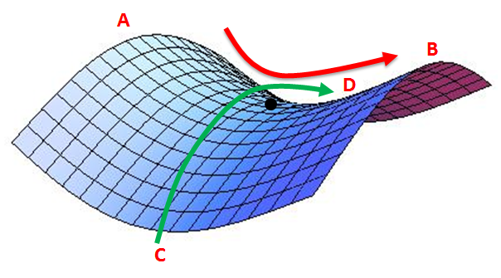
A
B
D
C

Slide 39
softmax
fc
fc
pool
conv
softmax
conv
fc
conv
softmax
fc
(repeated 3 times)
fc
pool
pool
softmax
pool
conv
conv
fc
conv
conv
conv
conv
(repeated 1-2 times)
(repeated 3-4 times)
(repeated 2 times)
input
input
input
input

Slide 40
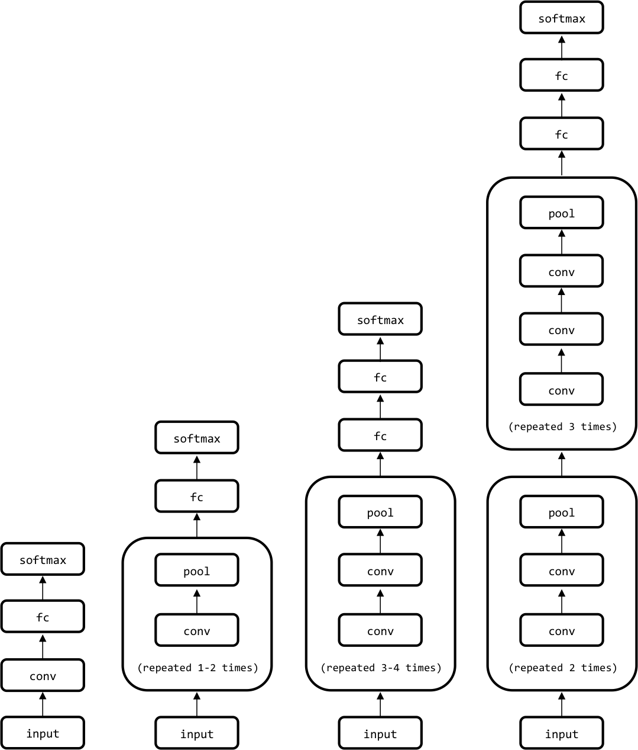

Slide 42
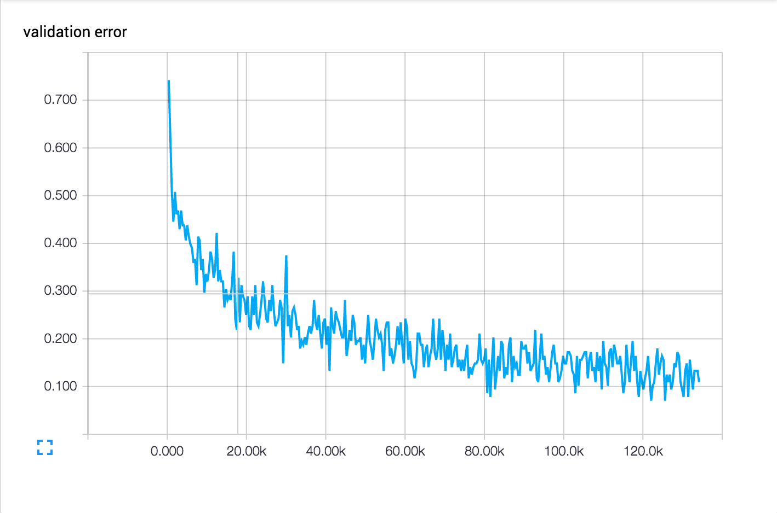
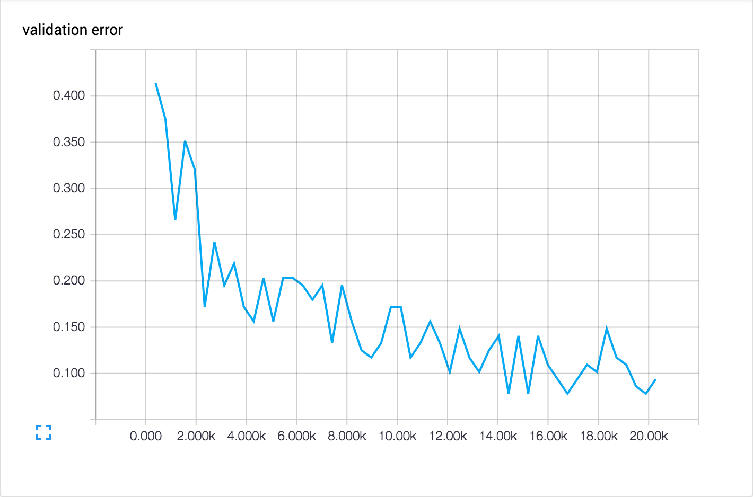

Slide 44
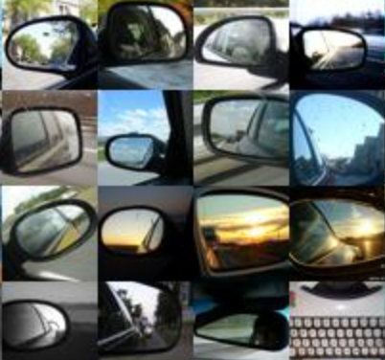

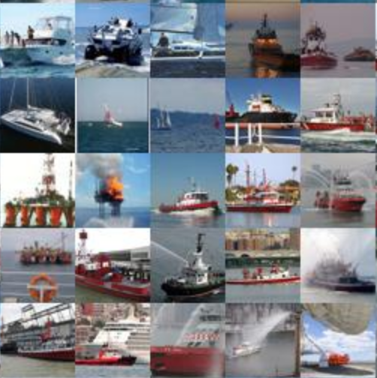
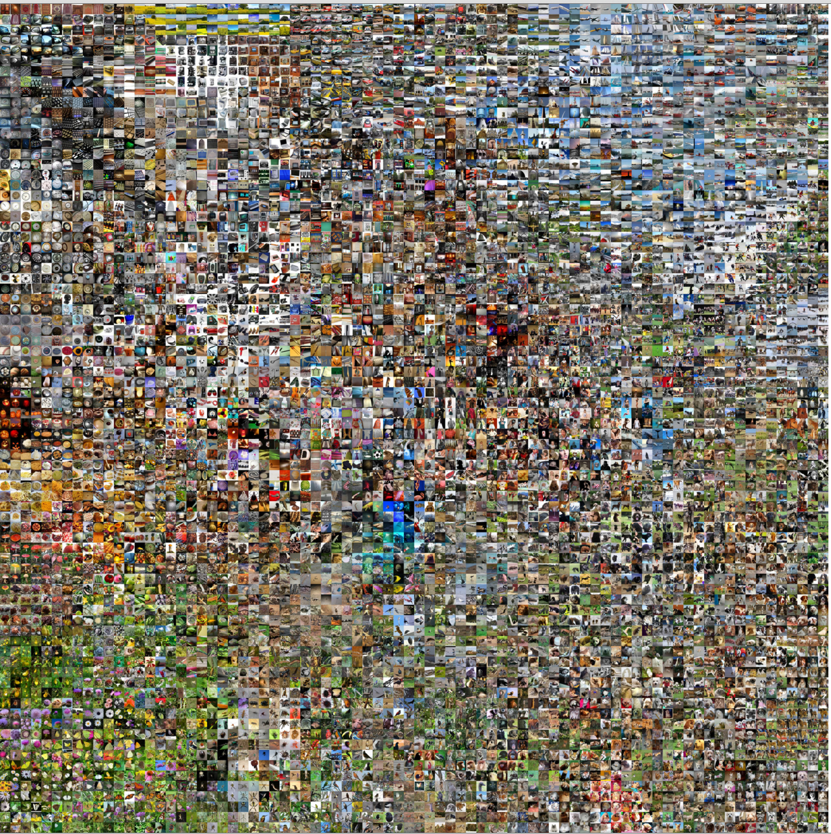
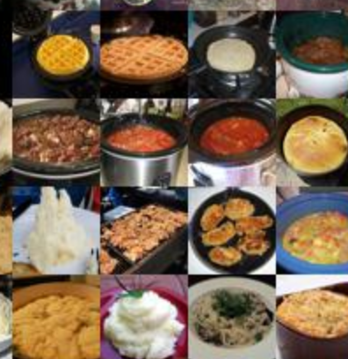
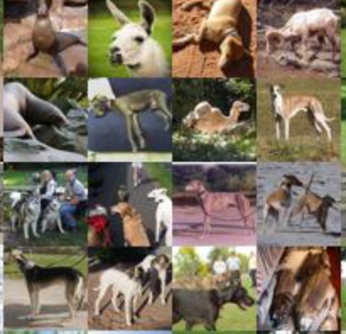
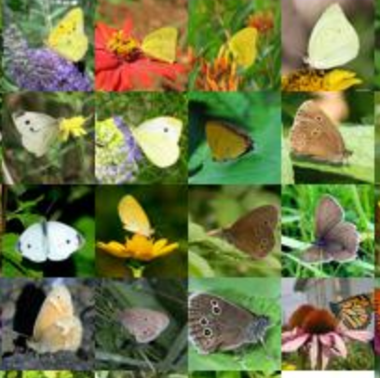
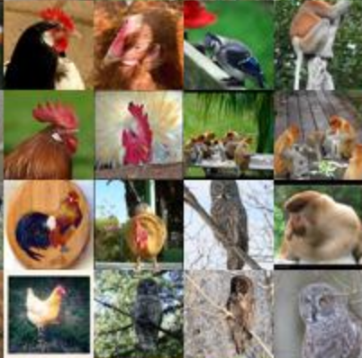
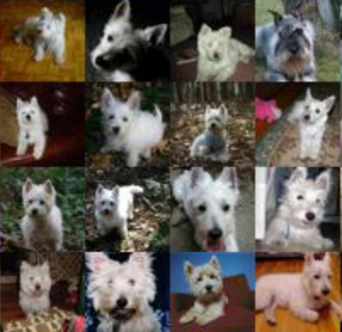

Slide 46




